Slide 1
Notes:
It is a methodology/ an approach for systematically organizing the best ways to develop systems efficiently. It includes, for example, descriptions of work to be performed at each stage of the development process and drafted documents.
Multiple methodologies—which differ according to viewpoint—are available. In terms of the development process, some example methodologies are "water-fall development," “Parallel development," and "agile-software development." And in terms of the design approach, some example methodologies are the process-oriented approach (POA), the data-oriented approach (DOA), the object-oriented approach (OOA)

Slide 3
Notes:
Data-centered methodologies utilize data models (Chapter 7) as the core of the system concept. For example, analysts
concentrate initially on identifying the data that must be available to produce the payroll and organizing that data into well-defined structures (e.g., employee work
log, employee pay rates, payroll tax tables, employee pay history, etc.).

Slide 4
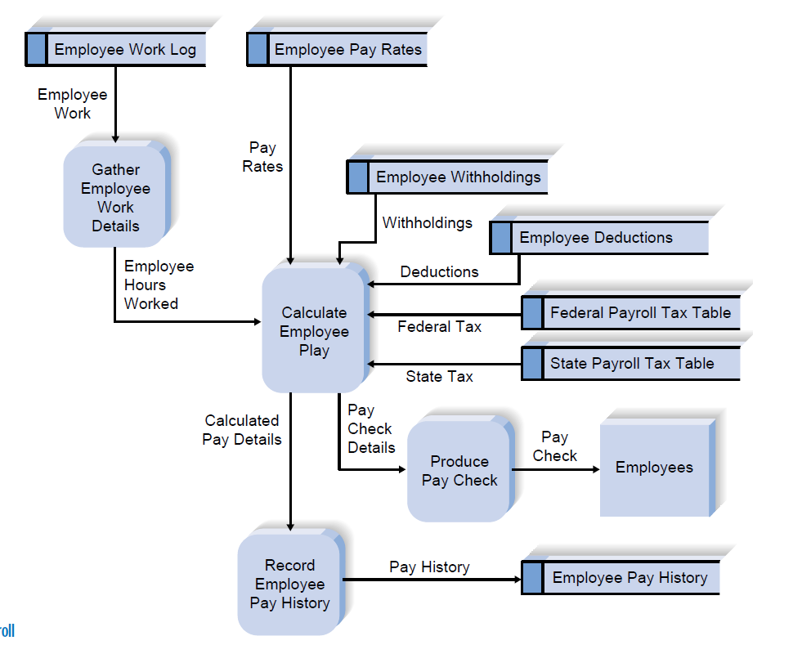

Slide 6
Methodology Categories
Another important factor in categorizing methodologies is the sequencing of the SDLC phases and the amount of time and effort devoted to each.
The three major categories of systems development methodologies that have evolved over time:
Structured Design,
Rapid Application Development (RAD)
Agile Development.
Each category represents a collection of methodologies that attempts to improve on previous practice, and varies in terms of the progression through the SDLC phases and the emphasis placed on each phase.
Notes:
4 In the early days of computing, the need for formal and well-planned life cycle methodologies was not well understood. Programmers tended to move directly from a very simple planning phase right into the construction step of the implementation phase;
This is the same approach that you may sometimes use when writing programs
for a programming class. It can work for small programs that require only
one programmer, but if the requirements are complex or unclear, you may miss
important aspects of the problem and have to start all over again, throwing away
part of the program (and the time and effort spent writing it). This approach also
makes teamwork difficult because members have little idea about what needs to be
accomplished and how to work together to produce a final product.

Slide 7
Structured Design Methodologies

Slide 8
Notes:
The key deliverables for each phase are typically voluminous
(often hundreds of pages in length) and are presented to the project sponsor for
approval as the project moves from phase to phase. Once the sponsor approves the
work that was conducted for a phase, the phase ends and the next one begins

Slide 13
Category 2: Rapid Application Development

Slide 15
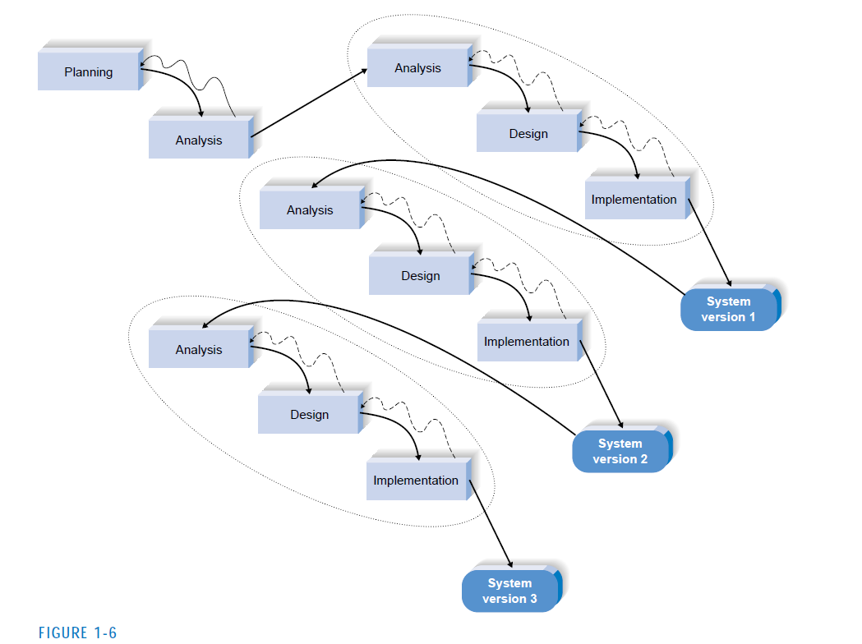

Slide 16
Notes:
With these methodologies, a basic analysis and design are performed, and work immediately begins on a system
prototype, a “quick-and-dirty” program that provides a minimal amount of
features. The first prototype is usually the first part of the system that the user
will use. This is shown to the users and the project sponsor, who provide reaction
and comments. This feedback is used to reanalyze, redesign, and reimplement a
second prototype that provides a few more features. This process continues in a
cycle until the analysts, users, and sponsor agree that the prototype provides
enough functionality to be installed and used in the organization

Slide 17
Advantages of Prototyping
The key advantage of a prototyping-based methodology is that it very quickly provides a system for the users to interact with, even if it is not initially ready for widespread organizational use. Prototyping reassures the users that the project team is working on the system (there are no longer time intervals in which the users perceive little progress), and the approach helps to more quickly refine real requirements
Notes:
Rather than attempting to understand system specification materials, the
users can interact with the prototype to better understand what it can and cannot do.

Slide 19
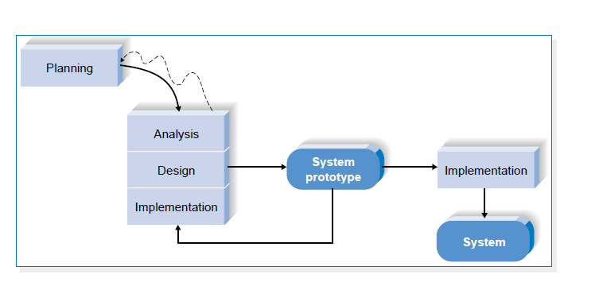

Slide 21
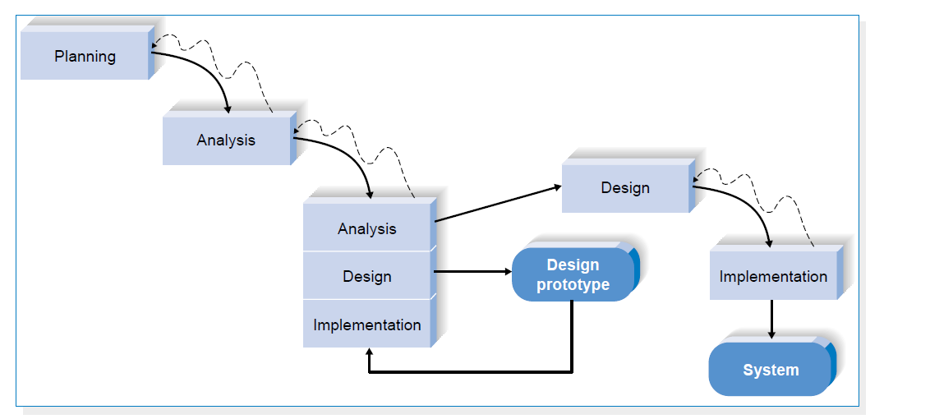
Notes:
Each of these issues is examined by analyzing, designing, and building a design prototype.
A design prototype is not a working system; it is a product that represents a part of
the system that needs additional refinement, and it contains only enough detail to enable users to understand the issues under consideration.
For example, suppose
users are not completely clear on how an order entry system should work. The analyst
team might build a series of HTML pages viewed using a Web browser to help
the users visualize such a system.

Slide 22
Category 3: Agile Development
Notes:
A third category of systems development methodologies is still emerging today:
Agile Development.7 These programming-centric methodologies have few rules and
practices, all of which are fairly easy to follow. They focus on streamlining the
SDLC by eliminating much of the modeling and documentation overhead and the
time spent on those tasks.

Slide 23
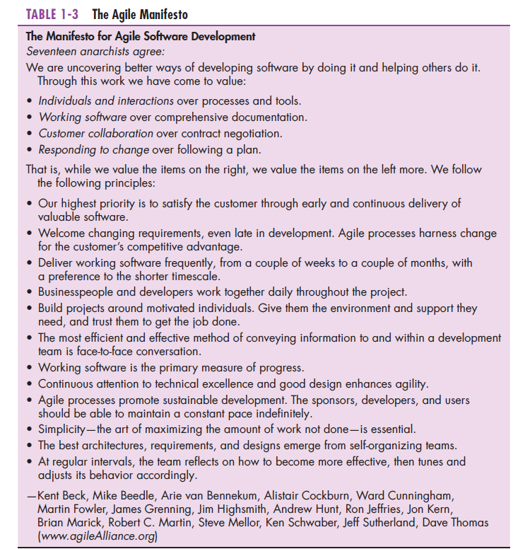

Slide 24


Slide 25
eXtreme programming
eXtreme Programming is an approach to software development put together by Beck and Andres (2004). It is distinguished by its short cycles, incremental planning approach, focus on automated tests written by programmers and customers to monitor the development process, and reliance on an evolutionary approach to development that lasts throughout the lifetime of the system.
The relevant parts of eXtreme Programming that relate to design specifications are:
how planning, analysis, design, and construction are all fused into a single phase of activity; and
(2) its unique way of capturing and presenting system requirements and design specifications.
With eXtreme Programming, all phases of the life cycle converge into a series of activities based on the basic processes of coding, testing, listening, and designing.

Slide 26
Under this approach, coding and testing are intimately related parts of the same process.
NB:
The programmers who write the code also develop the tests. The emphasis
is on testing those things that can break or go wrong, not on testing everything.
Code is tested as soon as after it is written. The overall philosophy behind eXtreme Programming is that the code will be integrated into the system it is being developed for and tested within a few hours after it has been written.
If all the tests run successfully, then development proceeds. If not, the code is reworked until the tests are successful.

Slide 27
Extreme Programming: XP

Slide 28
Notes:
First, the developers
must provide rapid feedback to the end users on a continuous basis. Second, XP
requires developers to follow the KISS (Keep It Simple, Stupid) principle. Third,
developers must make incremental changes to grow the system and they must embrace change, not merely accept it. Fourth, developers must have a qualityfirst
mentality.

Slide 30
Selecting the Appropriate Methodology

Slide 32
Notes:
Many of the RAD methodologies require the use of new tools and techniques
that have a significant learning curve. Often these tools and techniques
increase the complexity of the project and require extra time for learning. Once they
are adopted and the team becomes experienced, the tools and techniques can significantly
increase the speed in which the methodology can deliver a final system.
Users normally need to interact with technology
to really understand what the new system can do and how to best apply it
to their needs.
The RAD methodologies of prototyping and throwaway prototyping
are usually more appropriate when user requirements are unclear because they provide prototypes for users to interact with early in the SDLC. Agile development
may also be appropriate if on-site user input is available.

Slide 33
Notes:
When the system will use new technology with
which the analysts and programmers are not familiar (e.g., the first Web development
project with Java), applying the new technology early in the methodology
will improve the chance of success. If the system is designed without some familiarity
with the base technology, risks increase because the tools may not be capable
of doing what is needed. Throwaway prototyping-based methodologies are
particularly appropriate for a lack of familiarity with technology because they
explicitly encourage the developers to create design prototypes for areas with
high risks. Phased development-based methodologies are good as well because
they create opportunities to investigate the technology in some depth before the
design is complete. While one might think prototyping-based methodologies
would also be appropriate, they are much less so, because the early prototypes
that are built usually only scratch the surface of the new technology. Usually, it is
only after several prototypes and several months that the developers discover
weaknesses or problems in the new technology.

Slide 34
System Complexity
Complex systems require careful and detailed analysis and design.
Throwaway prototyping-based methodologies are particularly well suited to such detailed analysis and design, but prototyping-based methodologies are not.
Notes:
The throwaway prototyping-based methodologies have a relatively thorough
analysis phase that is used to gather information and to develop ideas for the system
concept. Many of the features suggested by the users may not be well understood,
however, and there may be challenging technical issues to be solved.

Slide 35
System Reliability
System reliability is usually an important factor in system development.
For some applications reliability is truly critical(e.g., medical equipment, missile control systems), while not important for others (e.g., games, Internet video).
Throwaway prototyping-based methodologies are most appropriate when system reliability is a high priority, because they combine detailed analysis and design phases with the ability for the project team to test many different approaches through design prototypes before completing the design.
Notes:
After all, who wants an unreliable system? However, reliability is
just one factor among several

Slide 36
Prototyping-based methodologies are generally not a good choice when reliability is critical because they lack the careful analysis and design phases that are essential for dependable systems.

Slide 37
Short Time Schedules
Projects that have short time schedules are well suited for RAD-based methodologies because those methodologies are designed to increase the speed of development.
Prototyping and phased development-based methodologies are excellent choices when timelines are short because they best enable the project team to adjust the functionality in the system on the basis of a specific delivery date.
Notes:
If the project schedule starts to slip, it can be readjusted by removing
functionality from the version or prototype under development. Waterfallbased
methodologies are the worst choice when time is at a premium because
they do not allow for easy schedule changes

Slide 38
Notes:
Project members are change agents who
identify ways to improve an organization, build an information system to support
them, and train and motivate others to use the system. Leading a successful organizational
change effort is one of the most difficult jobs that someone can do. Understanding
what to change, how to change it, and convincing others of the need for
change requires a wide range of skills
Analysts must have the technical skills to understand the organization’s existing
technical environment, the new system’s technology foundation, and the way in
which both can be fit into an integrated technical solution. Business skills are
required to understand how IT can be applied to business situations and to ensure
that the IT delivers real business value. Analysts are continuous problem solvers at
both the project and the organizational level, and they put their analytical skills to
the test regularly.

Slide 39
Skills and Roles
Technical Skills: Analysts must have the technical skills to understand the organization’s existing technical environment, the new system’s technology foundation, and the way in which both can be fit into an integrated technical solution.
Business skills : These are required to understand how IT can be applied to business situations and to ensure that the IT delivers real business value.
Analytical skills: Analysts are continuous problem solvers at both the project and the organizational level, and they put their analytical skills to the test regularly.
Interpersonal Skills: Often, analysts need to communicate effectively one-on-one with users and business managers (who often have little experience with technology) and with programmers (who often have more technical expertise than the analyst).
Management: Analyst need to manage people with whom they work and they must manage the pressure and risks associated with unclear situations.
Ethical: analysts must deal fairly, honestly, and ethically with other project team members, managers, and system users. Analysts deal with confidential information (e.g.,dissent among employees); it is important to maintain confidence and trust with all people.

Slide 40
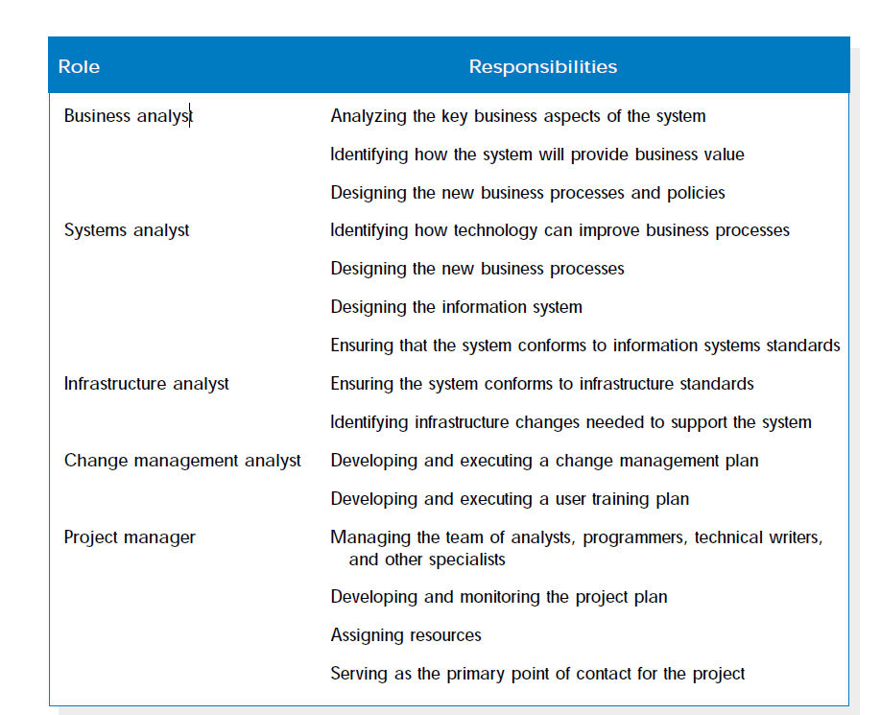

Slide 42
Guidelines for Developing a Prototype
Work in manageable modules
Build the prototype rapidly
Modify the prototype in successive iterations
Stress the user interface

Slide 43
Disadvantages of Prototyping
•It can be difficult to manage prototyping as a project in the larger systems effort
•Users and analysts may adopt a prototype as a completed system
Advantages of Prototyping
•Possibility for changing the system early in its development
•Opportunity to stop development on a system that is not working
•Possibility of developing a system that more closely addresses users’ needs and expectations

Slide 44
Users’ Role in Prototyping
•Honest involvement
•Experimenting with the prototype
•Giving open reactions to the prototype
•Suggesting additions to or deletions from the prototype

Slide 45
RAD (Rapid Application Development
An object-oriented approach to systems development that includes a method of development as well as software tools.
RAD Phases
Requirements planning
RAD design workshop
Implementation
Software Tools for RAD
Microsoft Access, Microsoft Visual Basic, Visual C++, and Microsoft .NET
Differ from one another in their:
Capabilities to support client/server applications
Ease of use and the amount of programming skills that is required

